Slide 1

Crime Rate in relation to Weather in Atlanta
Can weather patterns be used to predict crime?

Slide 2

Presented by: The Crime Ninjas
Gary Groscost
Prudhvi Krishna Sannapareddy
Pradip Raodeo
Steven Rufus
Emmanuel Yoacel Okecha
Hwa Hara
James Dellinger
Kafayat Lawal
Megan Harper
Michael Damas

Slide 3
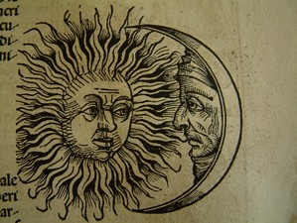
Background Information
Heat Hypothesis:
“The heat hypothesis states that hot temperatures can increase aggressive motives and behaviors”
Craig A Anderson – Dept. of Psychology, Iowa State University, Ames, Iowa
“Violent crime rates rose, on average, 5.7% on days when the temperature was above 85 degrees.”
Kilian Heilmann & Matthew E. Kahn – Dept. of Economics, University of Southern California, Los Angeles, California
Moon Phases and Behavior
” But now, my lord. It is the very error of the moon; She comes more nearer earth than she was wont, And makes men mad.”
Othello – William Shakespeare
81% of mental health workers claim a relationship between human illness and a full moon
Francis OJ, Kopke BJ, Affatato AJ, Jarski RW. Psychiatric Presentations During All 4 Phases of the Lunar Cycle.

Slide 4
Background Info Cont.
Part 1 Offenses
Serious crimes that occur on a regular basis and are likely to be reported to law enforcement
Standardized under the FBI Uniform Crime Reporting guidelines
Part 1 offenses used in our dataset and analysis
Aggravated Assault
Auto Theft
Nonresidential Burglary
Residential Burglary
Homicide
Vehicle Larceny
Non-Vehicle Larceny
Rape
Residential Robbery
Pedestrian Robbery
Commercial Robbery

Slide 5

Research Questions
Do certain weather conditions influence the volume of part 1 offenses in Atlanta, GA?
Do certain weather conditions influence the type of part 1 offenses committed in Atlanta, GA?
Does the Moon phase influence the volume or type of part 1 offenses in Atlanta, GA?
Can we predict the rate of part 1 offenses committed in Atlanta, GA using a linear regression model?

Slide 7
Limitations

